Slide 1
SPRINT BURNUP &
SPRINT BURNDOWN

Slide 2




Burn up Chart
The Burn up Chart provides a visual representation of a sprint's completed work compared with its total scope. It offers insights on your project's progress, as well as offers warnings to help you maintain your project's health; you can instantly identify problems such as scope creep or a deviation from the planned project path.
Click your Jira icon ( )
Click Projects then select the relevant project
Click Reports, then select Burn up Chart.
To choose a different sprint, or a different measurement for the vertical axis, simply click the drop-down menus.

Slide 3
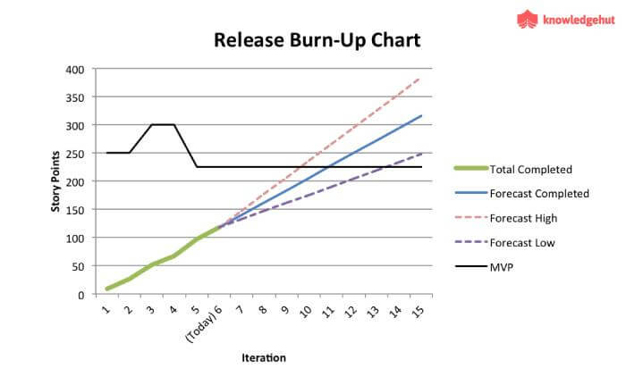
Burn up Chart
You can view the Burn up Chart for individual sprints in your project, meaning you can see the amount of work completed vs the amount of work remaining on a day-to-day basis.

Slide 4
Before you begin
The Burn up Chart only applies to Scrum boards.
Story Points on sub-tasks are not included in the Burn up Chart. (Only Story Points on parent tasks are included.)
Understanding the Burn up Chart
The vertical axis represents the amount of work, and can be measured in different ways such as story points, issue count, or estimates. The horizontal axis represents time in days.
The distance between the lines on the chart is the amount of work remaining. When the project has been completed, the lines will meet.
Examine the 'Work scope' line to identify any scope creep.

Slide 5
Burn Down Chart
Purpose
When do I plan to finish?
Am I on track to finish?
Is every member of my team on track?
Should I replan early?

Slide 6
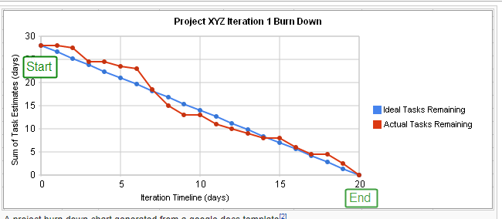
Continue..

Slide 7
Data for your release
List of person, story / task, planned effort days
Later add finished planned days (and maybe actual effort
project | story | task | person | start
my project | small maze | file | john | 4
my project | small maze | connect robot | jane | 3
my project | small maze | run | jane | 5
my project | end | light sense | john | 5
my project | end | report win | jane | 3
ideal - remaining effort |  |  |  | 20

Slide 8
Make chart and Graph
Set up all days you expect
Formula to show ideal diminishing planned days consumption
Day before - total effort needed / total days you have
Ex: =H7-$E$7/10
Set up one column per day
At stand up, fill in the effort remaining
Insert / chart / line graph

Slide 9
Concepts
Man hours
Planned vs Actual vs Earned
Track at person / task level with groupings up to story level
Adjustments
Drop tasks
Adjust Acceptance Test Plan
Waterfall
Gantt chart
Critical Path

Slide 10


